Slide 1
PBIS Social Skills
Day 3

Slide 2
Working with Others
Remember, this week we are talking about Working with Others.
Let’s review the four steps.

Slide 3
Working with Others
Step 1: Identify the task to be completed.

Slide 4
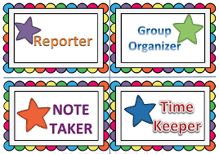
Working with Others
Step 2: Assign tasks to each person.

Slide 5
Working with Others
Step 3: Discuss ideas in a calm, quiet voice and let everyone share their ideas.

Slide 6
Working with Others
Step 4: Work on tasks until completed.

Slide 7
Working with Others
When you are able to work with others in this way, you have a better chance to complete the assignment.
Okay, today we are going to talk more about the second step.
Step 2 is “Assign tasks to each person.”

Slide 8
Working with Others
Why do you think it is important to assign tasks to each person? What are some jobs that would be helpful when doing group work?
Who would like to come to the front of the classroom and role play with me what it would look like to assign tasks to each person?

Slide 9
Working with Others
What do you think would happen if you didn’t assign tasks to each person?
Who would like to come to the front of the classroom and role play with me what a non-example of this step would look like?

Slide 10
Working with Others
Work in groups on a laptop to write a Diamante Poem about working with others.
Consider using the ReadWriteThink program to compose your poem.
When you are finished, please print the final poem or email it to your teacher.

Slide 11
Working with Others
Project for the Week
Work with your table group to create a comic strip about working with others
Be sure to include:
The four steps you learned for Working with Others.
Characters and dialog.
Plan your comic strip by deciding how many characters there will be, what situation they will be in, and what they will say. Consider creating the final comic strip using the ReadWriteThink comic creator

