Slide 1
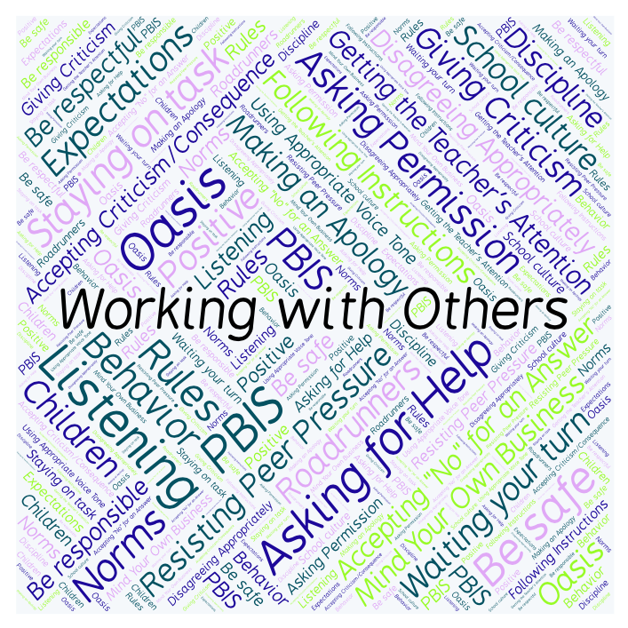
PBIS Social Skills
Day 4

Slide 2
Working with Others
Remember, this week we are talking about Working with Others.
Let’s review the four steps.

Slide 3
Working with Others
Step 1: Identify the task to be completed.

Slide 4
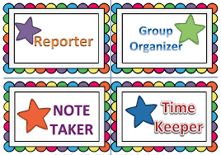
Working with Others
Step 2: Assign tasks to each person.

Slide 5
Working with Others
Step 3: Discuss ideas in a calm, quiet voice and let everyone share their ideas.

Slide 6
Working with Others
Step 4: Work on tasks until completed.

Slide 7
Working with Others
When you are able to work with others in this way, you have a better chance to complete the assignment.
Okay, today we are going to talk more about the third and fourth steps.
Step 3 is “Discuss ideas in a calm, quiet voice and let everyone share their ideas.”

Slide 8
Working with Others
Why is it important to discuss ideas in a calm, quiet voice and let everyone share their ideas?
Turn to your elbow partner and practice step 3.

Slide 9
Working with Others
What do you think would happen if you didn’t discuss ideas in a calm, quiet voice or if you didn’t let everyone share their ideas?
Turn to your elbow partner and demonstrate a non-example of this step.

Slide 10
Working with Others
Step 4 is “Work on task until completed.”
Why do you think it is important to work on your task until it is completed? What other Social Skill would help us do this? What do you do if you have completed the task?
Turn to your elbow partner and practice step 4.

Slide 11
Working with Others
What do you think would happen if you didn’t work on the task until it was completed?
Turn to your elbow partner and demonstrate a non-example of this step.

Slide 12
Working with Others
Log in to Edmodo and navigate to the “PBIS Social Skills” group. If you haven’t already joined, the code is w.483zg.
Find the “Working with Others Discussion Prompt” and respond in writing by clicking on the Reply button.

Slide 13
Working with Others
Project for the Week
Work with your table group to create a comic strip about working with others
Be sure to include:
The four steps you learned for Working with Others.
Characters and dialog.
Plan your comic strip by deciding how many characters there will be, what situation they will be in, and what they will say. Consider creating the final comic strip using the ReadWriteThink comic creator

